Slide 1
Round table Presentation
Linda Kamau

Slide 2
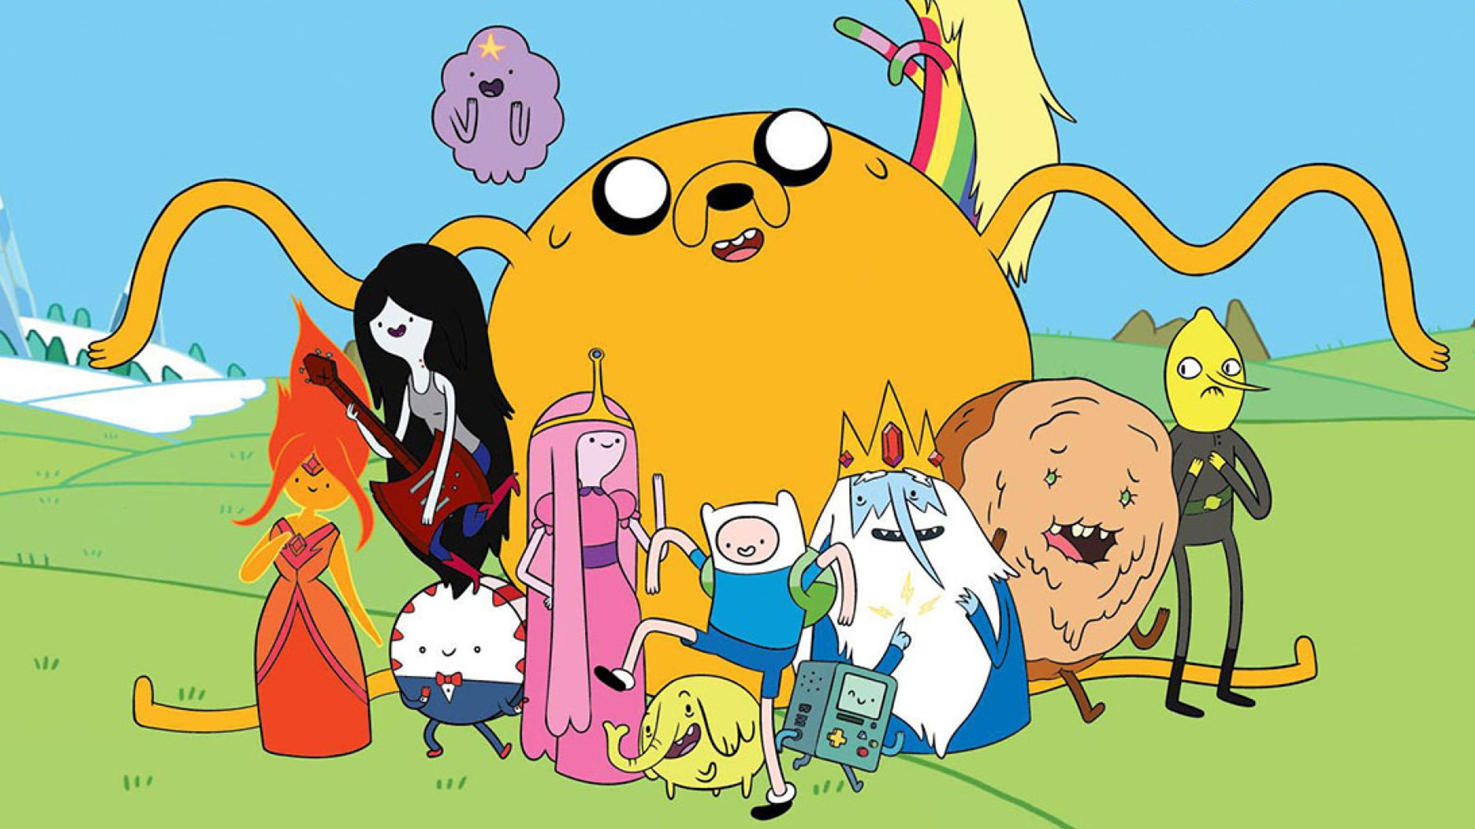
Idea #1 – Adventure Time Game

Slide 3
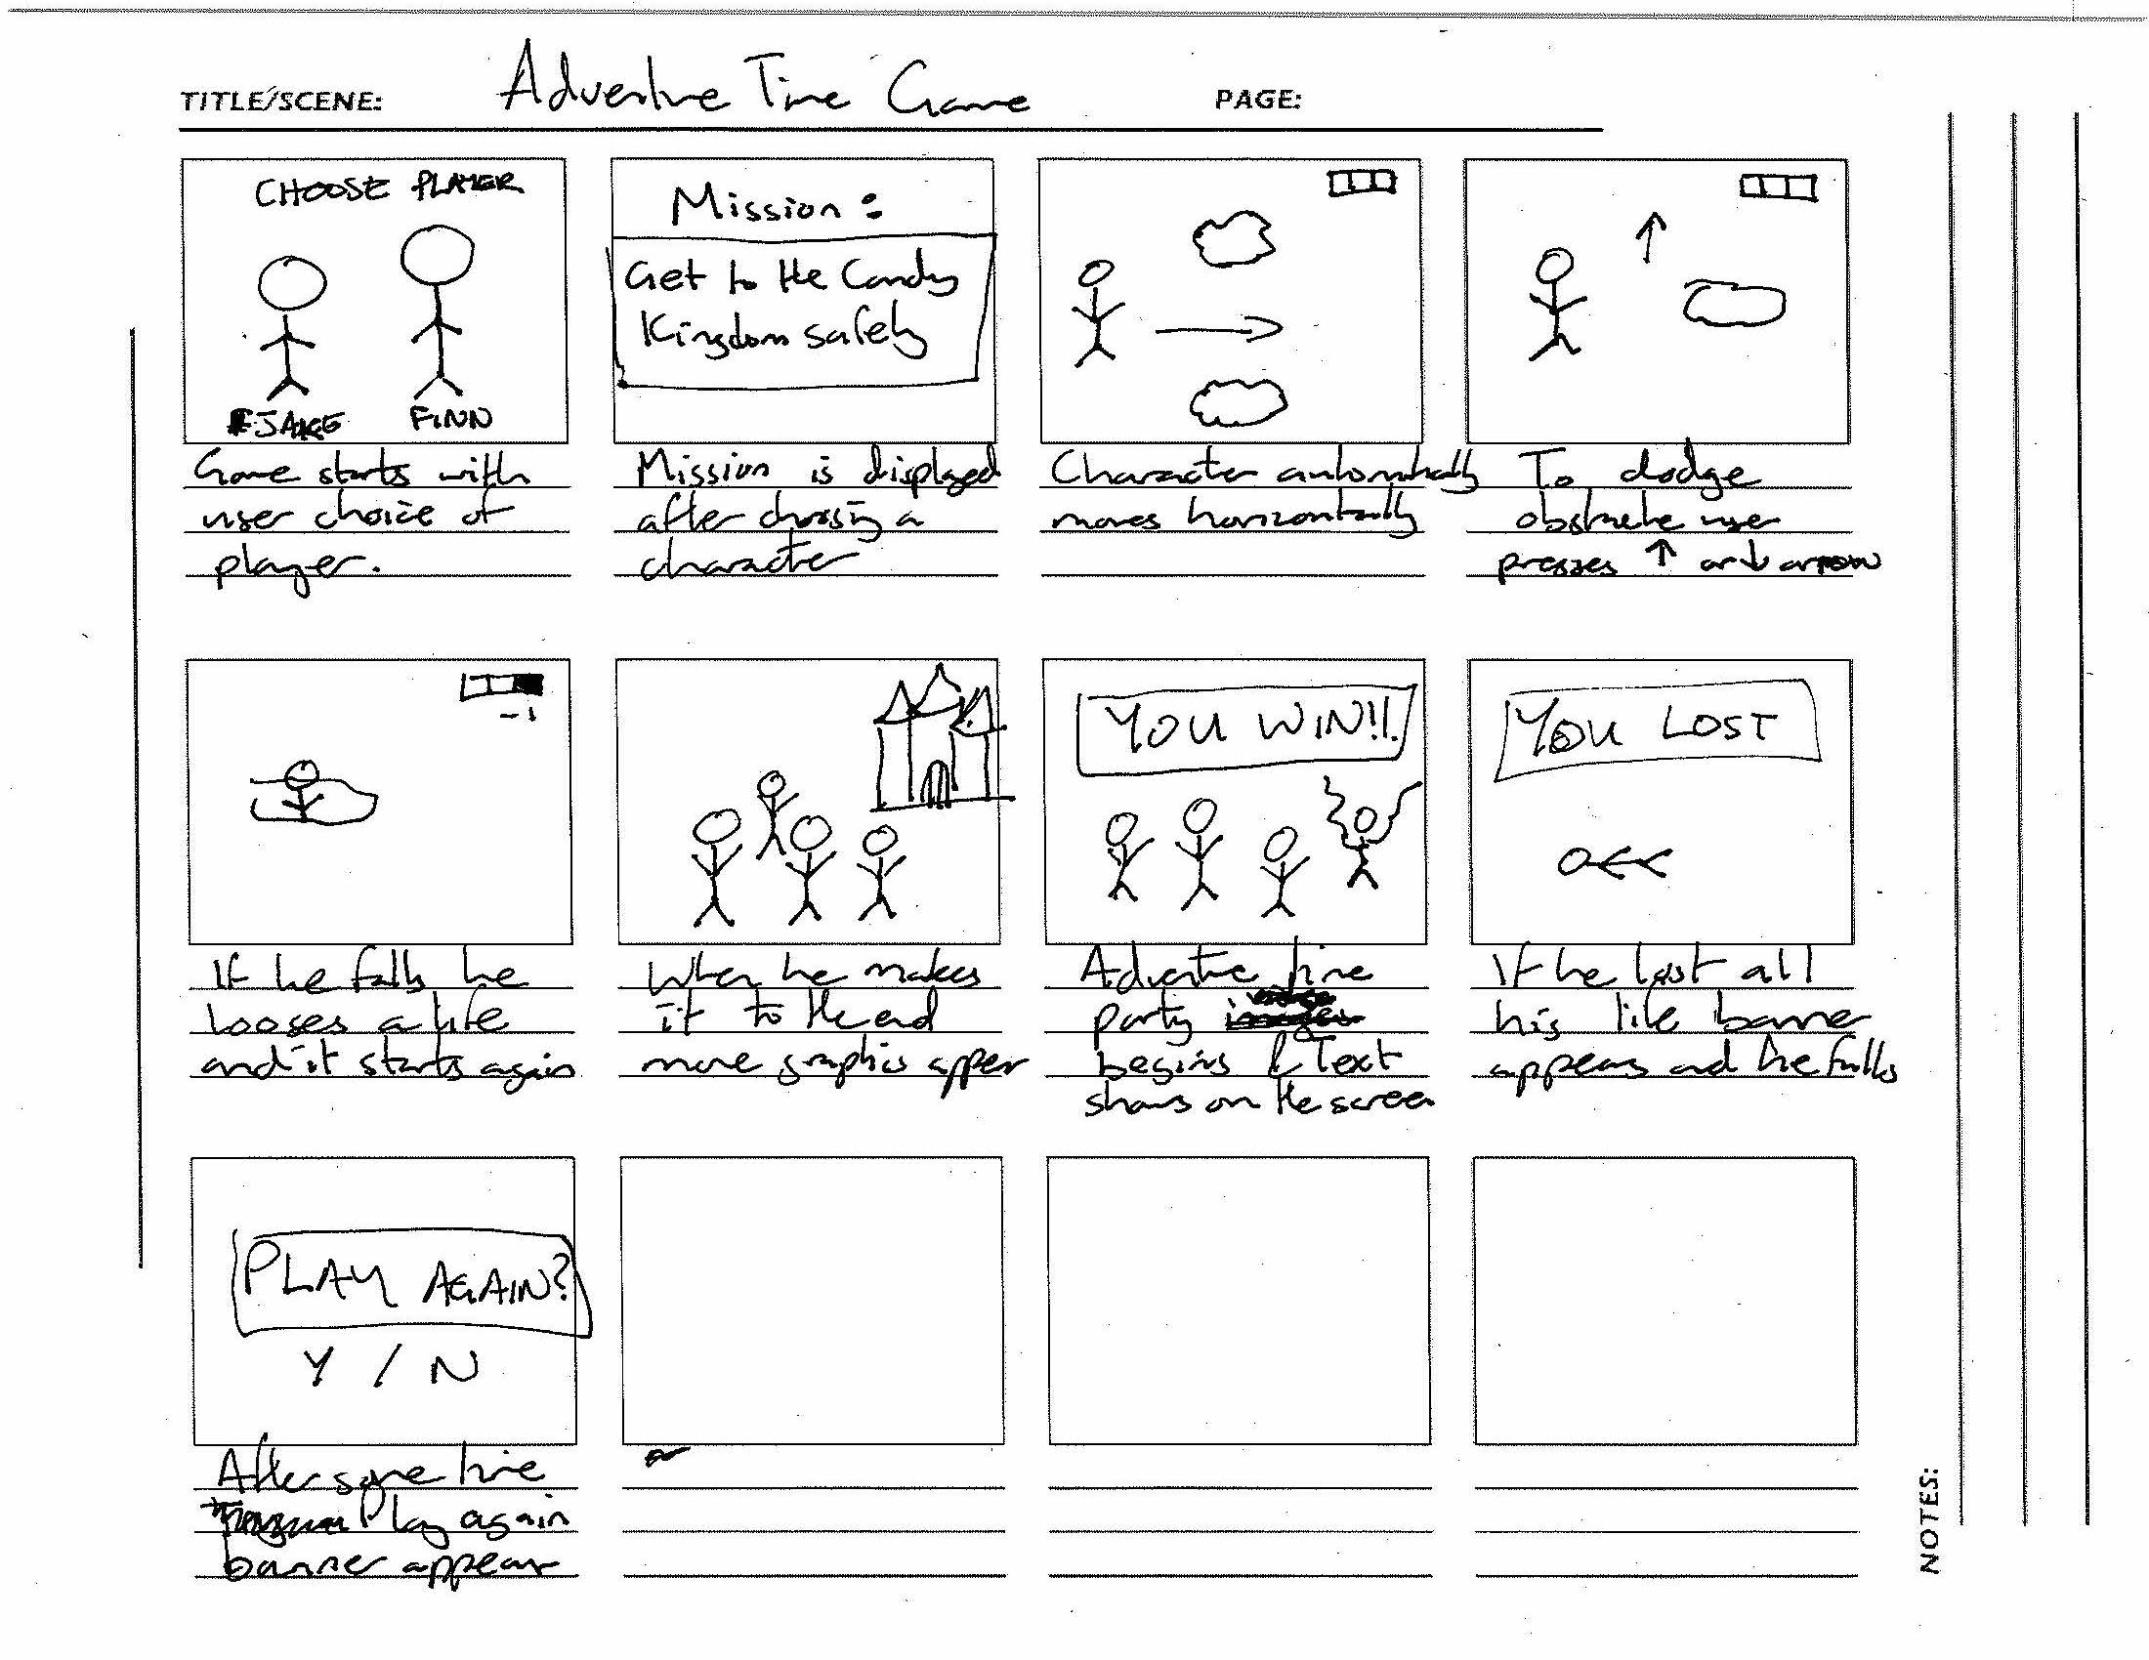
Storyboard 1

Slide 4
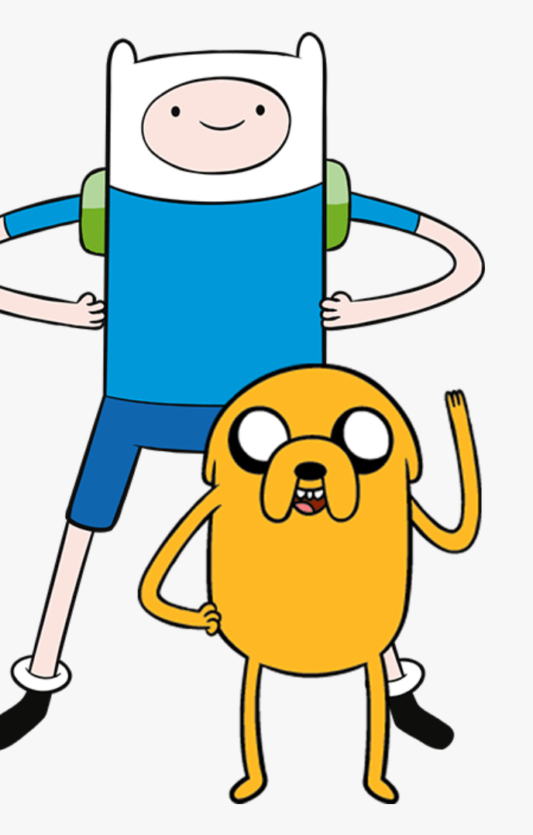
Adventure Time Game
Inspired by the cartoon, a simple game of getting to the Candy Kingdom while avoiding obstacles.
Player has 3 chances to win.
I will be using some of the images from the cartoon.
https://www.openprocessing.org/sketch/521767
https://www.openprocessing.org/sketch/638320

Slide 5
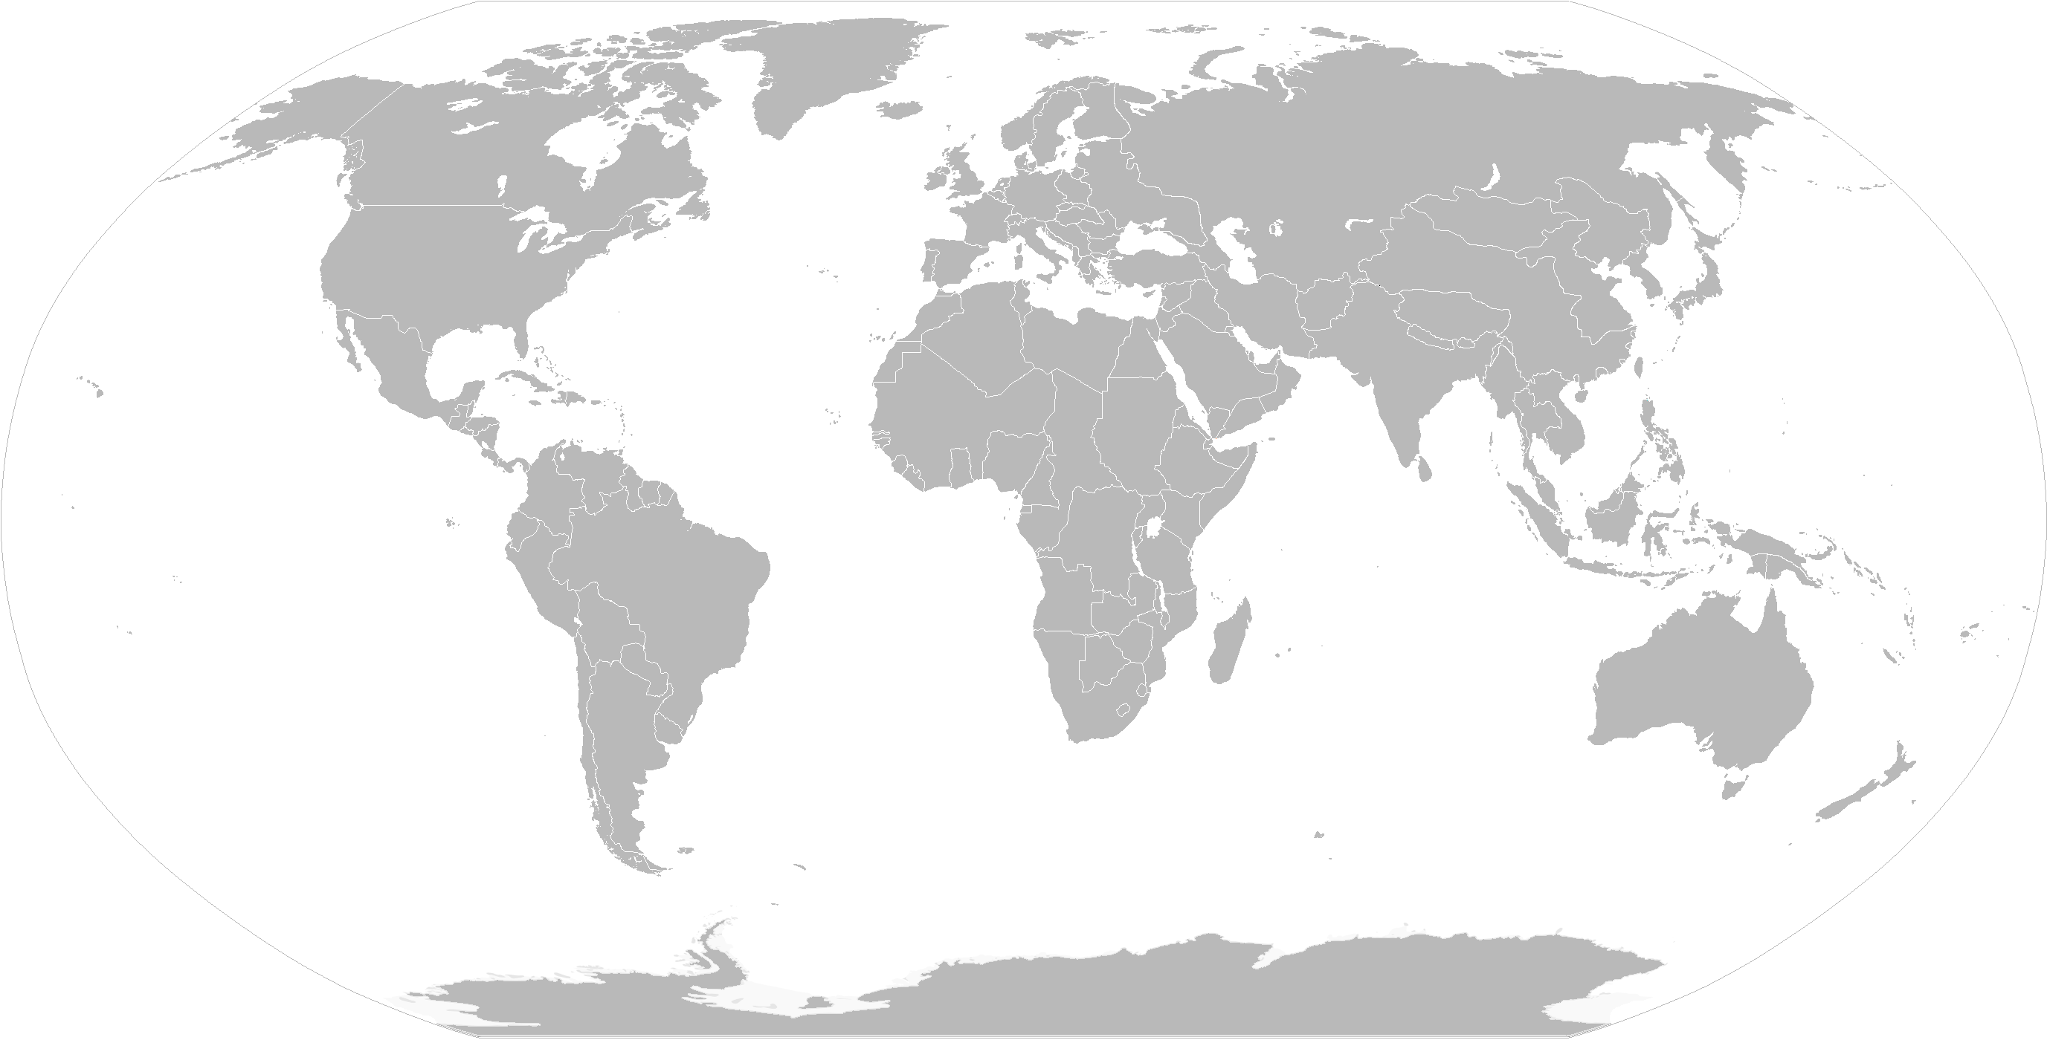
Idea #2 – around the world

Slide 6
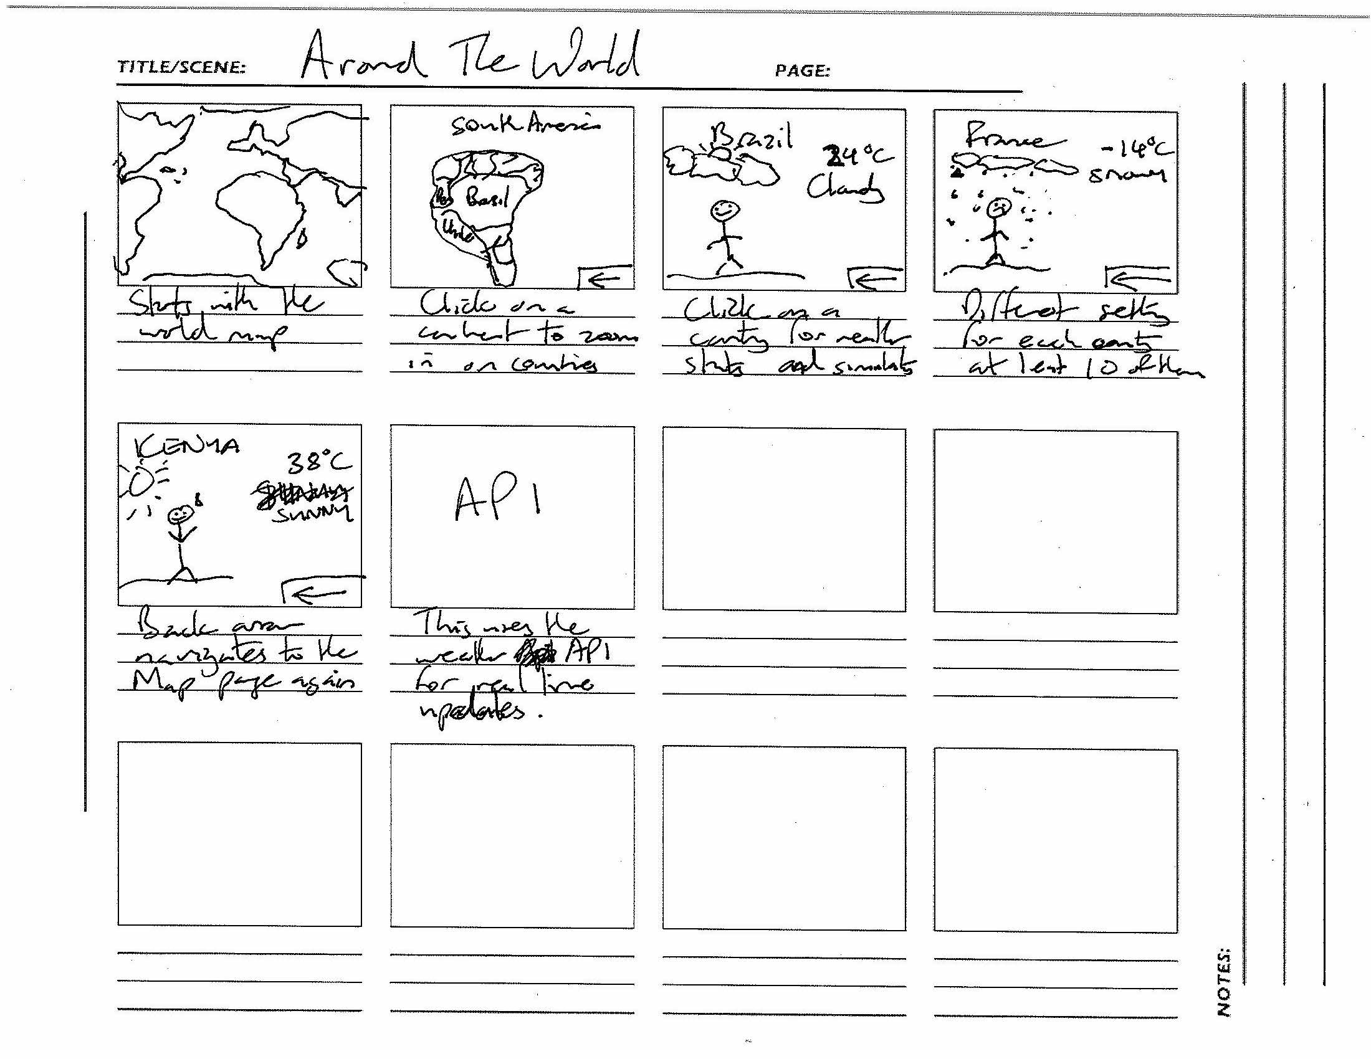
Storyboard 2

Slide 7
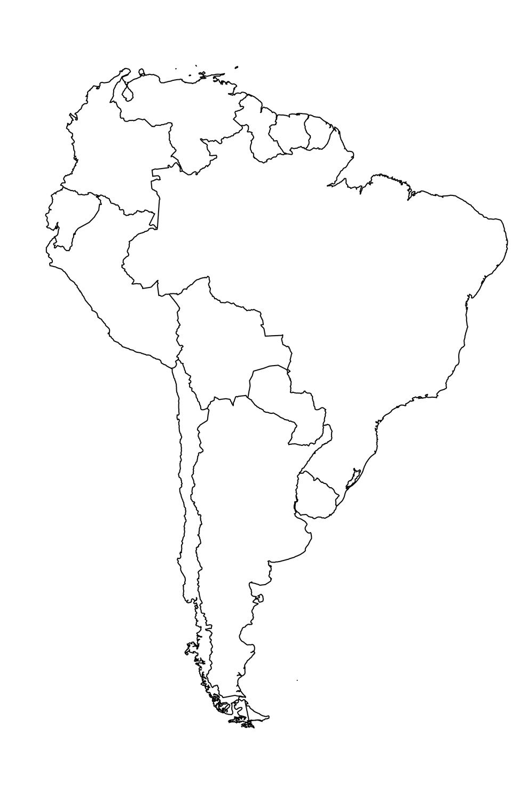
Around the World - Details
The weather is different in different parts of the world.
Using the Open Weather API I can access real-time data of the temperature and attach a corresponding graphic.
https://openweathermap.org/api
The countries I will include are : USA, Mexico, Peru, Brazil, Italy, Norway, India, Philippines, Kenya, Ghana, Australia.

Slide 8
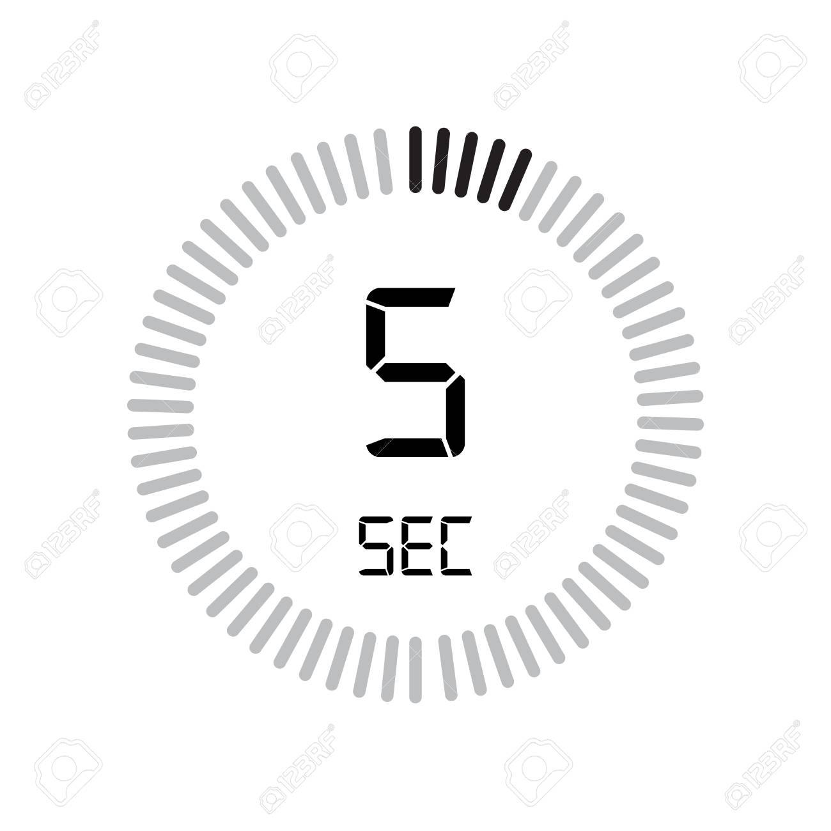
Idea #3 – Every 5 Seconds

Slide 9
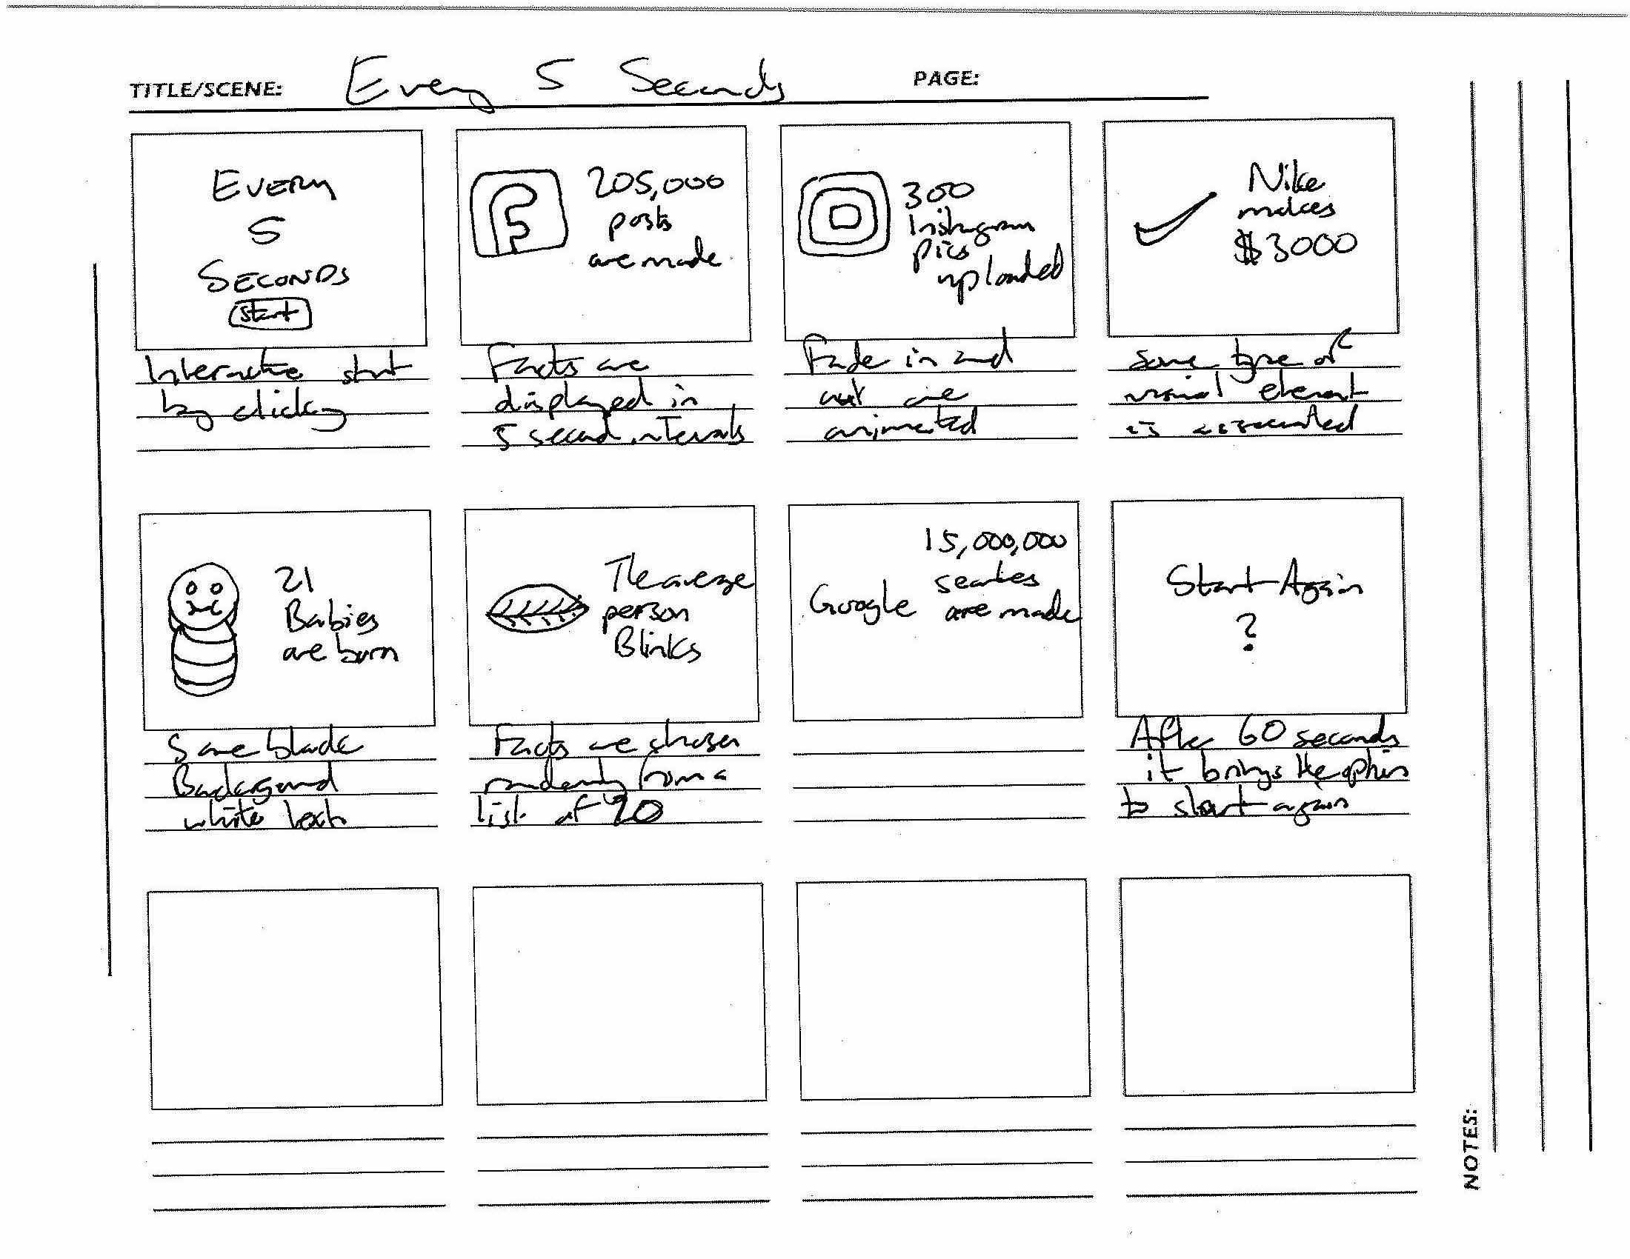
Storyboard 3

Slide 10

Every 5 seconds
Sources of the facts are on:
https://www.buzzfeed.com/christianz/50-things-that-happen-every-5-seconds-1pyg
https://www.omnicalculator.com/everyday-life/every-second
Incorporate sound into the narrative like background music.
https://www.audioblocks.com/royalty-free-audio/tension
Facts change every 5 seconds
Each fact has a corresponding image.
http://www.sbs.com.au/theboat/

Slide 11
References
https://visme.co/blog/10-mind-blowing-interactive-stories-that-will-change-the-way-you-see-the-world/
https://www.openprocessing.org/sketch/638320
https://www.openprocessing.org/sketch/521767
http://www.sbs.com.au/theboat/

